Slide 1
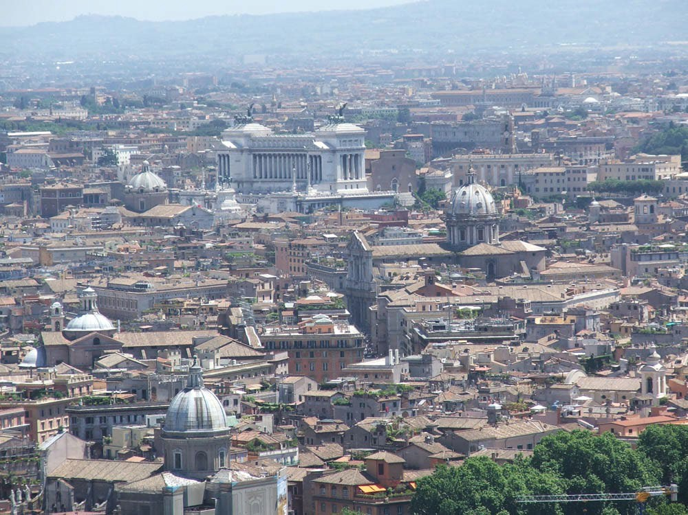
Social Science in Rome
Summer Semester
Four weeks in June

Slide 2
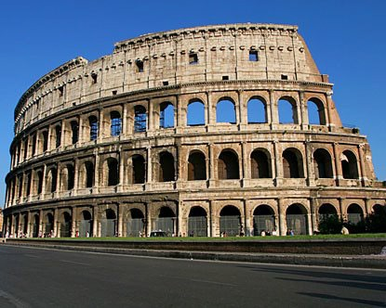
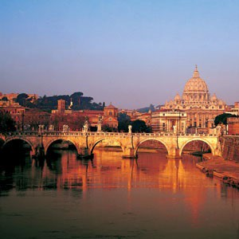
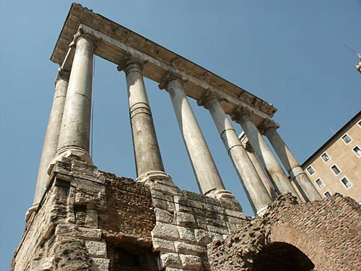
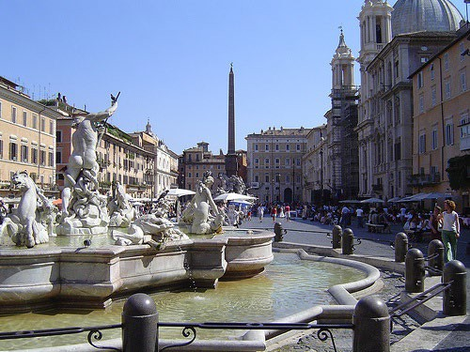
Social Science in Rome: Summer 2022
Spend Your Summer in the Eternal City!!!

Slide 3
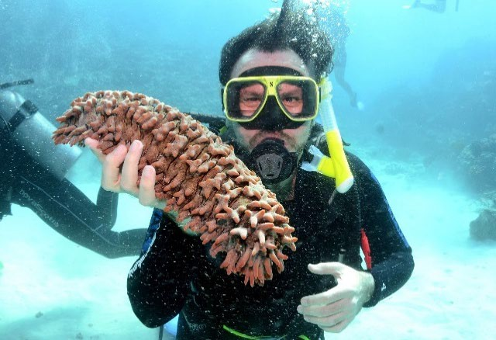
Igor Vojnovic
Igor Vojnovic formerly taught in the Sydney Sports Program. He is a professor of geography, urban studies, city planning and environmental studies at MSU.
His academic interests include urban geography, urban planning and design, global development processes, and urban-environmental analysis.
Contact Information for Igor Vojnovic: vojnovic@msu.edu 517-353-5987
447 Berkey Hall

Slide 4
Social Science in Rome offers more to its students than just studying in the Eternal City!!!!
Your class schedule (Monday-Wednesday 8:30am-1:30pm and Thursday 9am-1:30pm), allowing for weekend travel and plenty of extra exploring throughout the week!
Your small group of fellow study abroaders will soon become your closest friends!
The cultural experience of living in the ancient capital of Rome offers every student a unique experience!

Slide 5
Don’t miss this opportunity to live in the Eternal City!!!
For more information on the Rome program:
We will have Zoom Rome Study Abroad Informational meetings throughout Fall and Spring.
Visit the Office of Study Abroad Room 108 at the International Center and ask about the Social Science in Rome Summer Program.
Visit the Social Science in Rome web page: https://gusp.msu.edu/events/Study-Abroad-Social-Science-in-Rome-2021.html
Visit, call or email Faculty Leader: Professor Igor Vojnovic (Global Urban Studies 447 Berkey Hall, 353-5987, vojnovic@msu.edu).

Slide 6
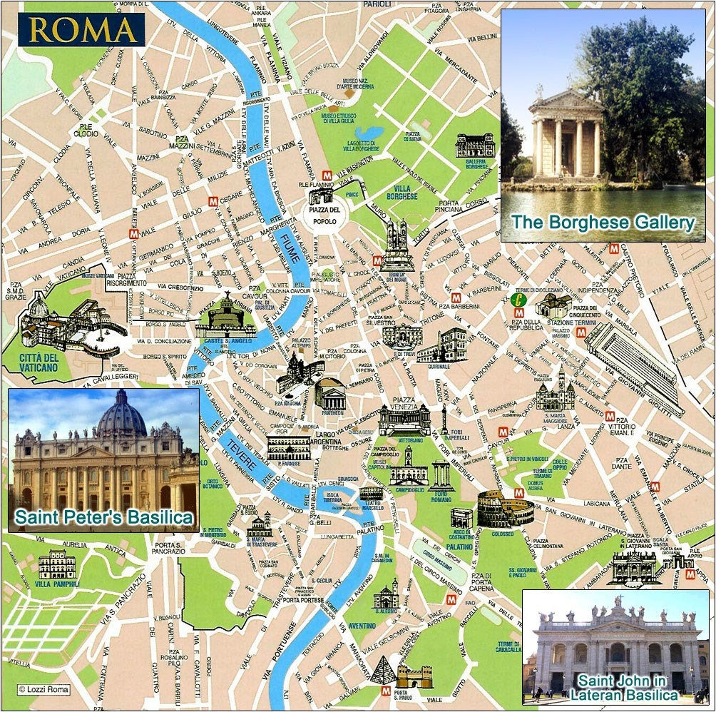
Live and study in the historic center of Rome:
Student accommodation and classroom are located near two famous Roman Piazzas: Campo de Fiori and Navona, both abundant with shops, cafes, restaurants and fountains!!!!
The Vatican
Campo de Fiori
Piazza Navonai
Colosseum

Slide 7
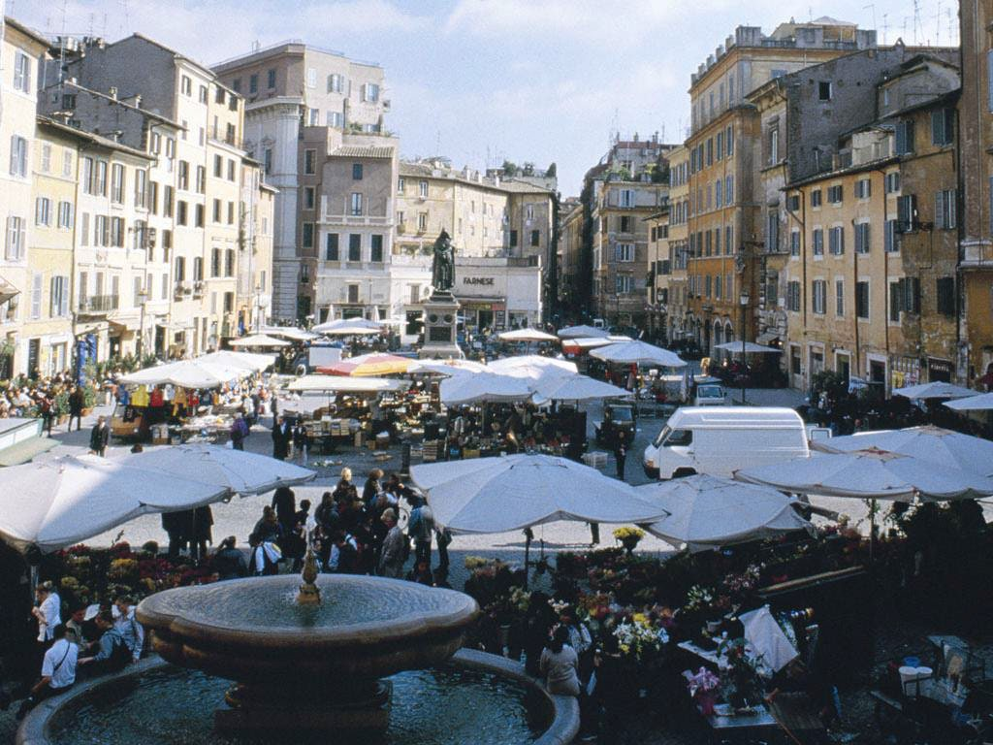
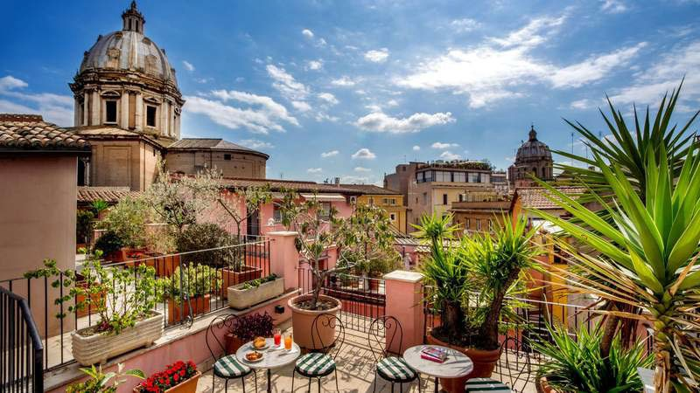
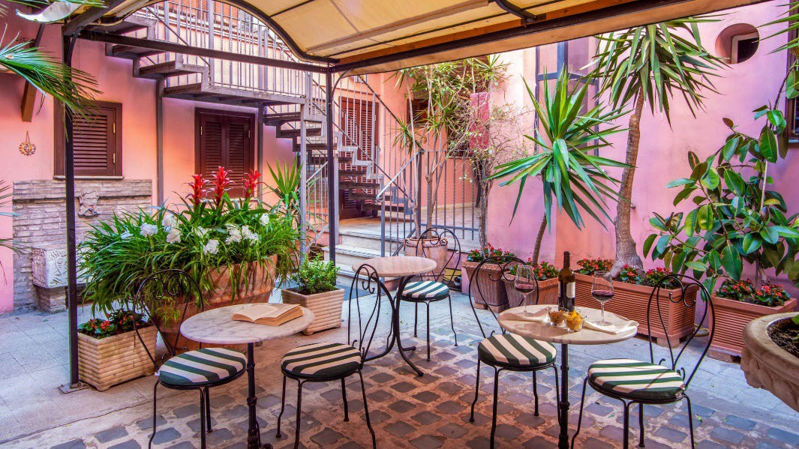
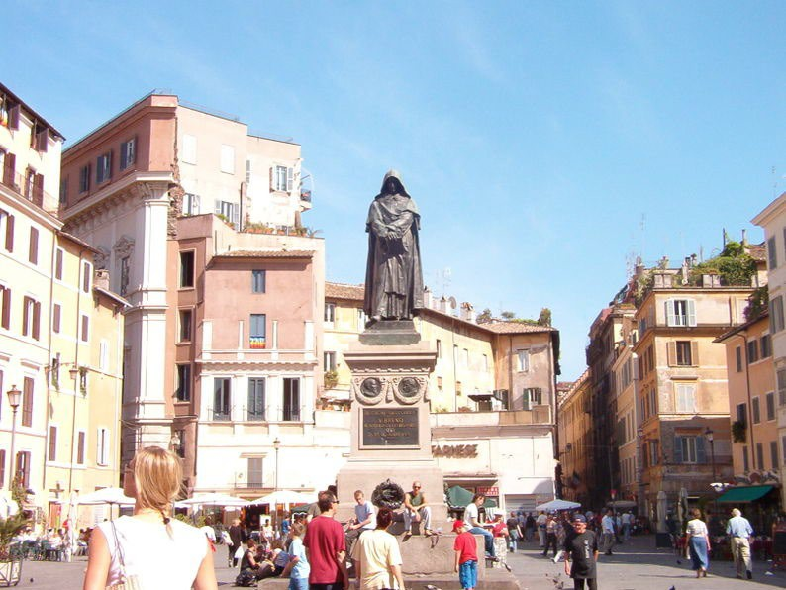
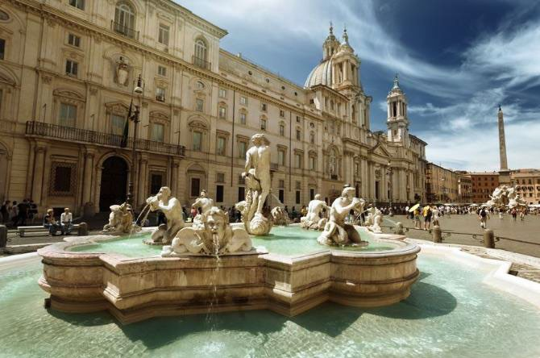
The location of ITALIAIDEA and Hotel Sole are near Piazzas Navona and Campo de Fiori!!!
Hotel Sole
Piazza Campo de Fiori
Piazza Navona

Slide 8
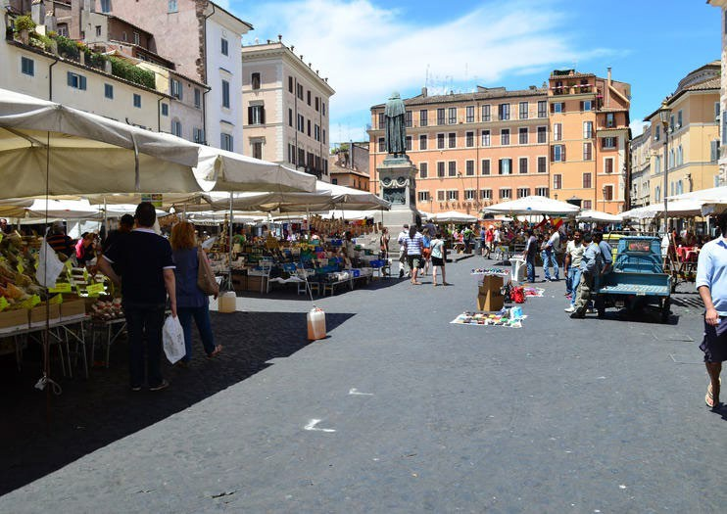
Campo de Fiori!
Daily fresh food stands and delis, restaurants, bakeries, bars, cafes

Slide 9
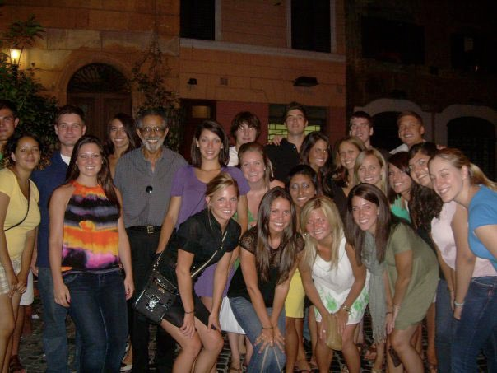
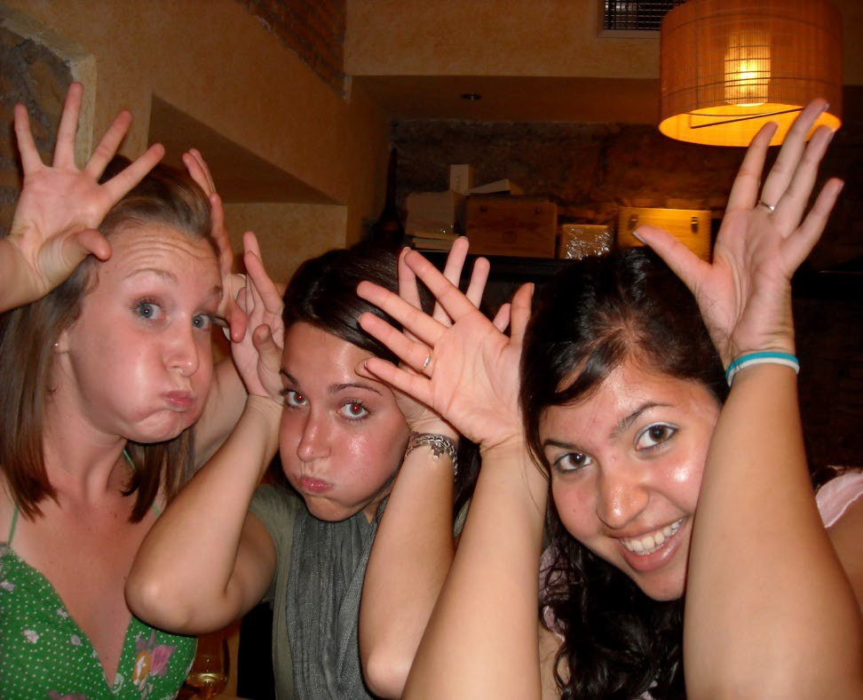
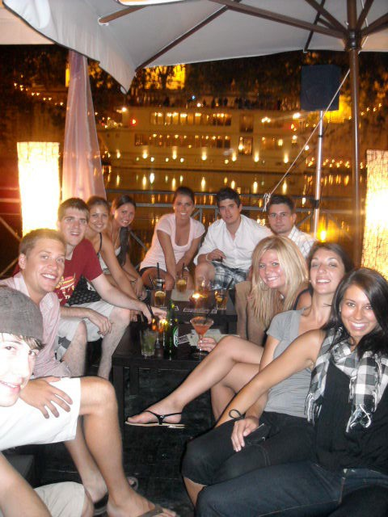
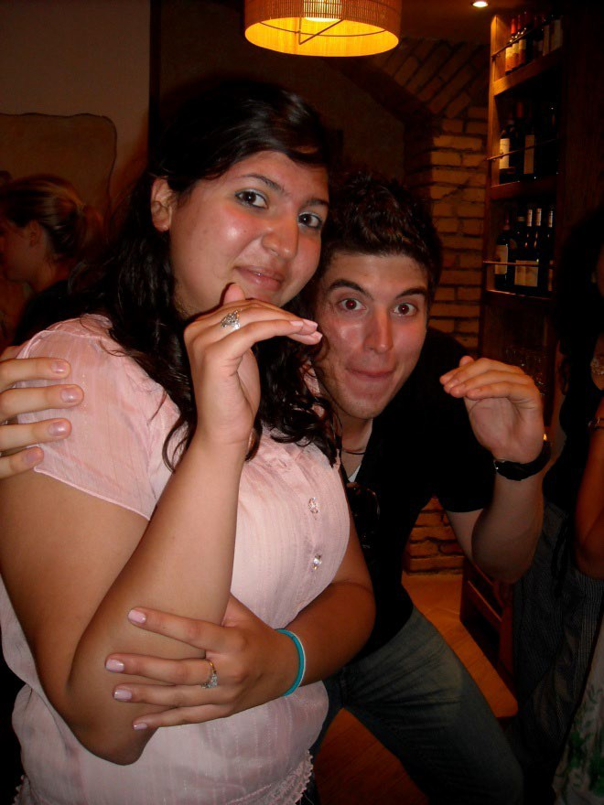
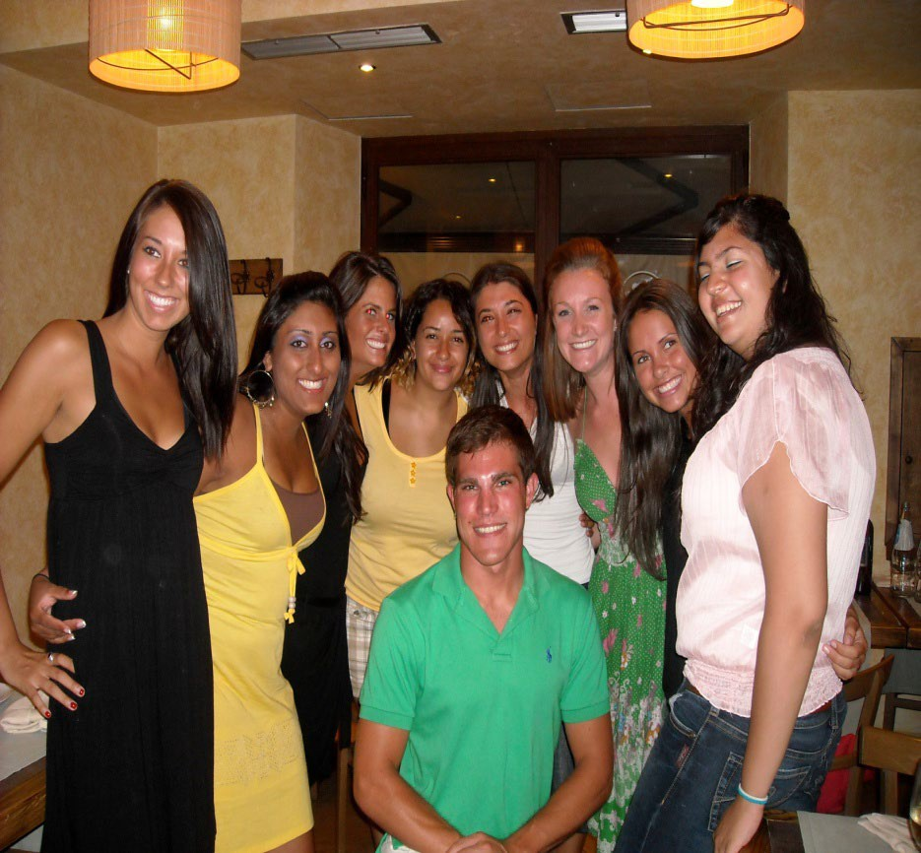
MAKE NEW FRIENDS!!!
Rome Students: 2007-2014

Slide 10
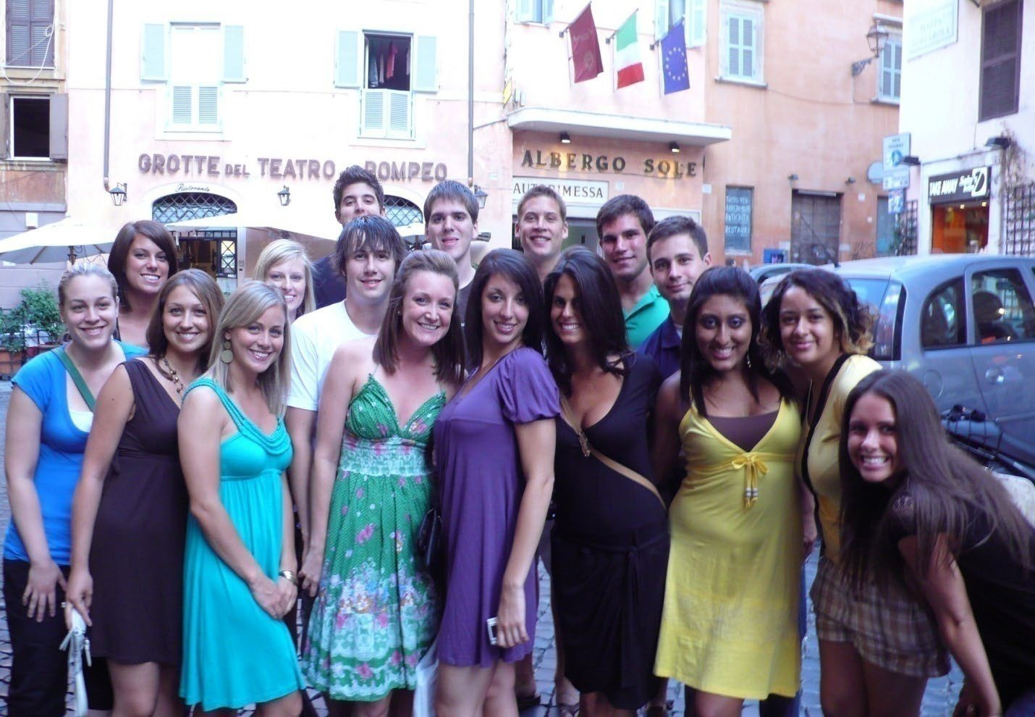
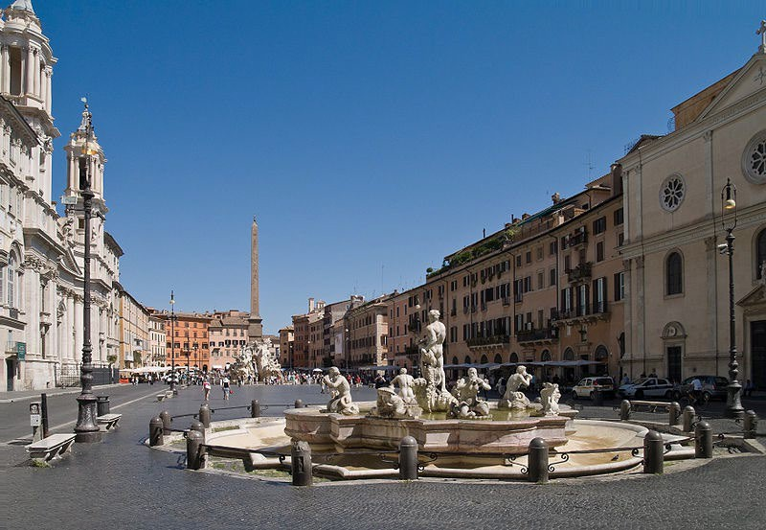
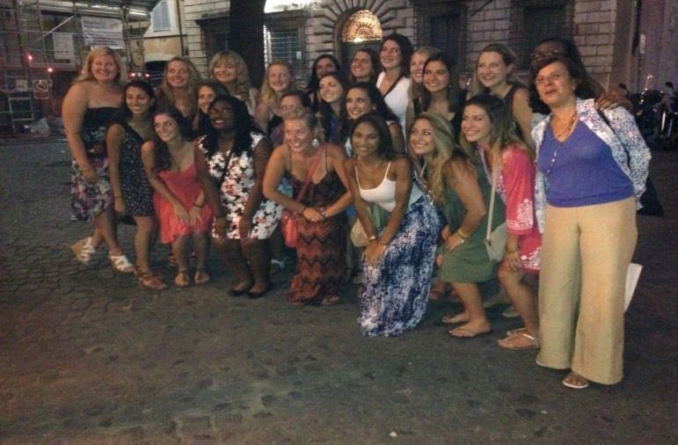
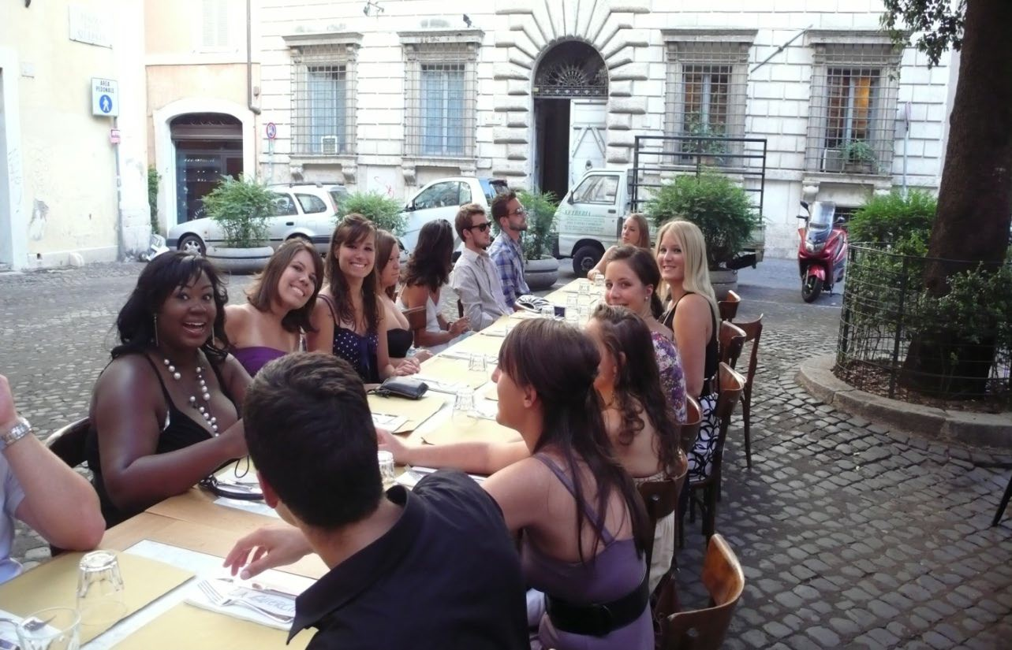
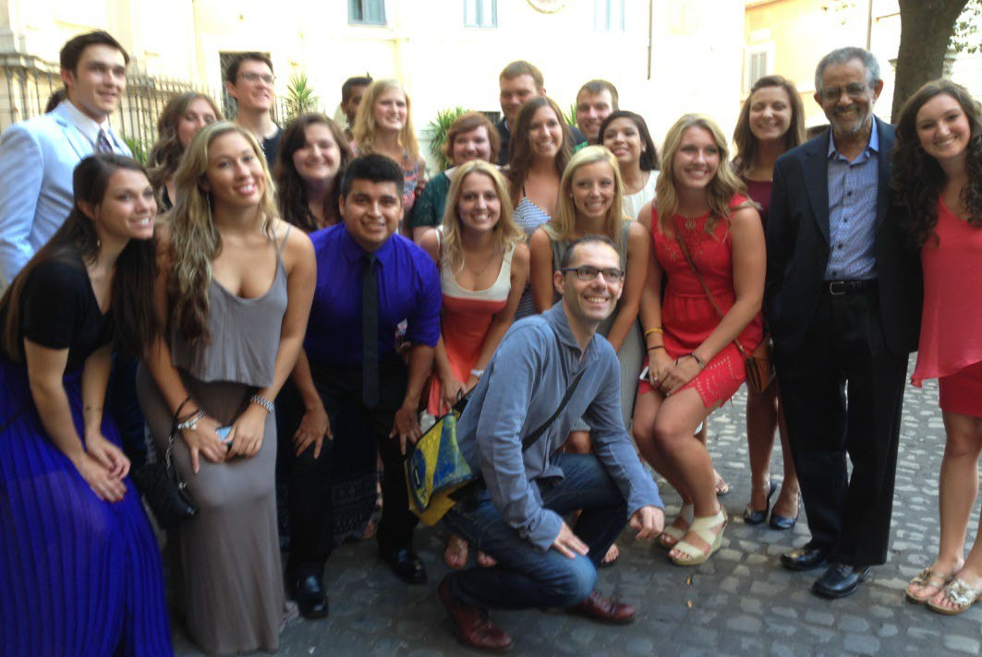
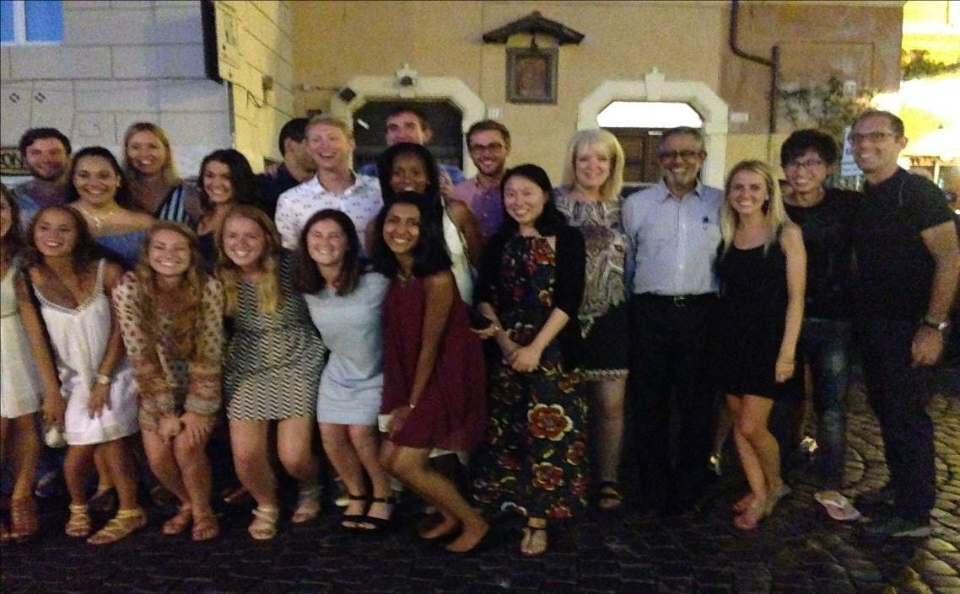
Live in the Historic Center of Rome
Piazza Navona
Piazza Campo de Fiori
Rome Students 2007-2016

Slide 11
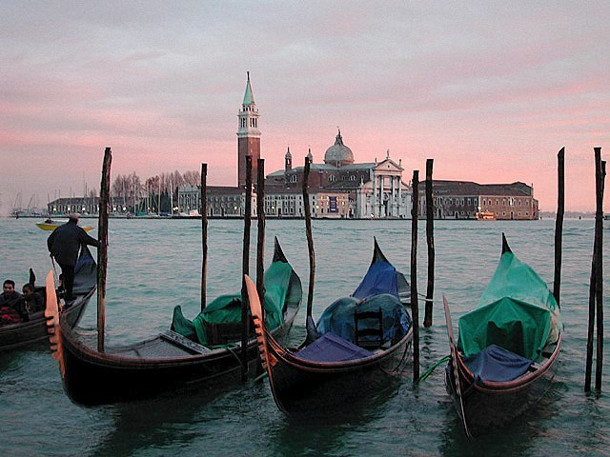
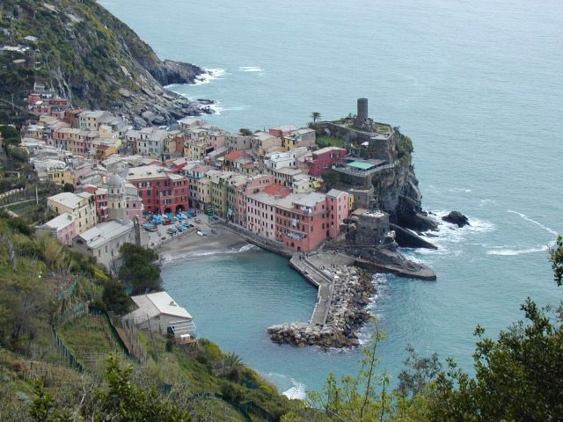
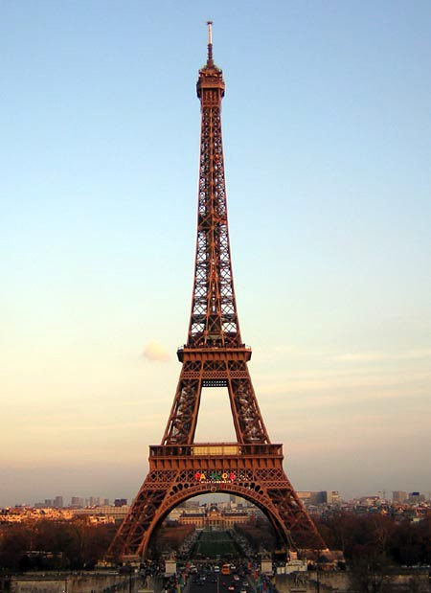
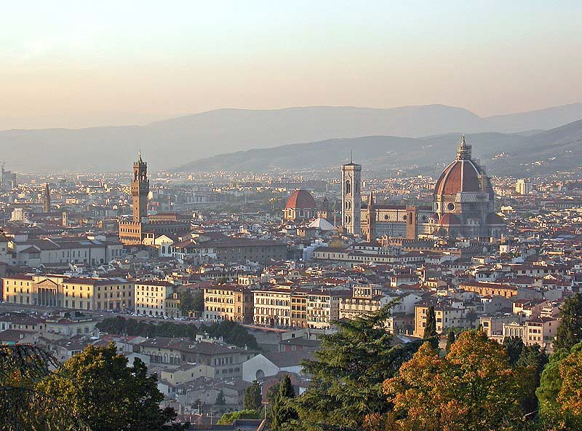
See New Places!!!
Venice
Western Italian Coast
Enough time on weekends to explore Rome, the rest of Italy, and Europe!
Paris
Florence

Slide 12
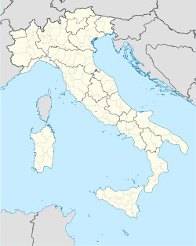
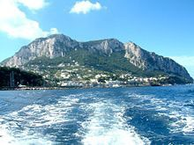
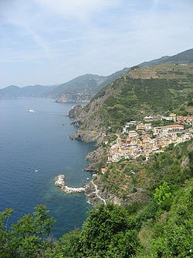
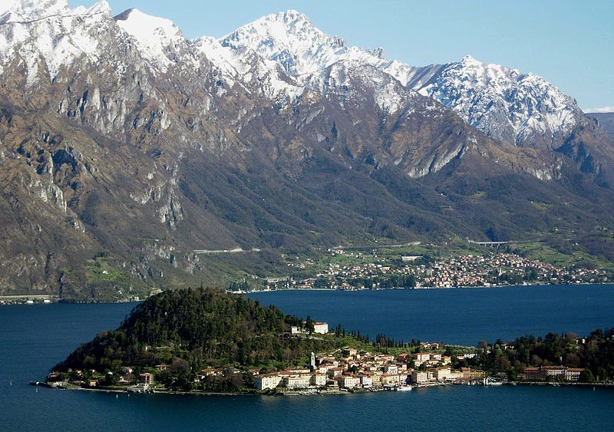
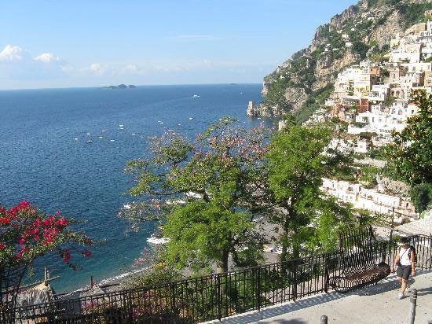
Among Nature’s Gift to Italy
3
1 Island of Capri
2 Cinque Terre
2
4
1
3 Bellagio and Lake Cuomo
4 Positano and the Amalfi Coast

Slide 13
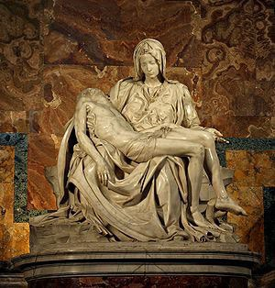
Visit some of the most famous objects of Renaissance art in Rome
Michelangelo’s Pieta
(1475-1564)
in St. Peter’s Basilica
13

Slide 14
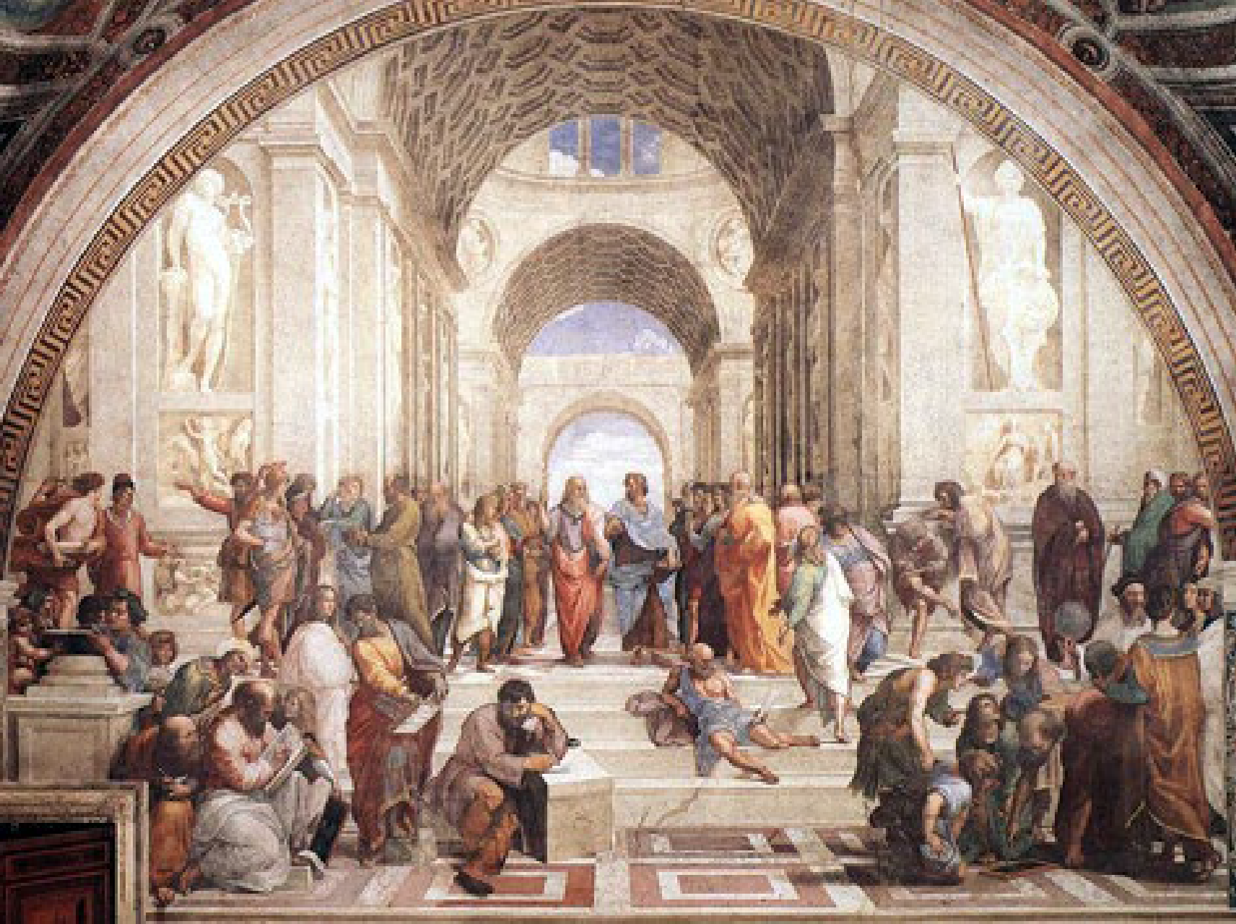
Rafael’s School of Athens (1483-1520) at the Vatican Museum, Rome
14

Slide 15
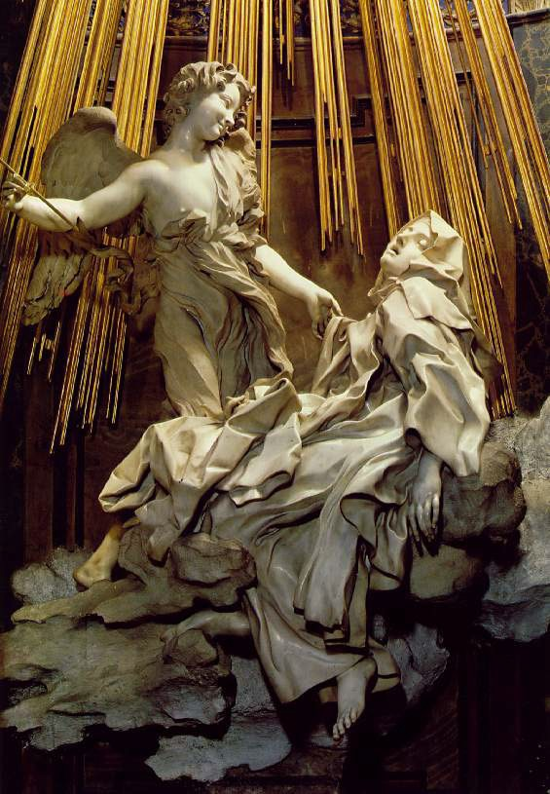
Gian Lorenzo Bernini’s (1598-
1642) Ecstasy of St. Theresa at Santa Maria della Vittoria in Rome
15

Slide 16
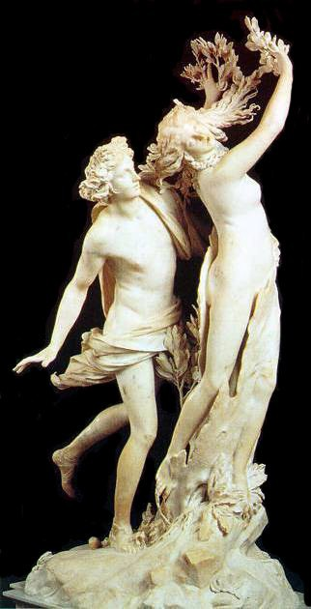
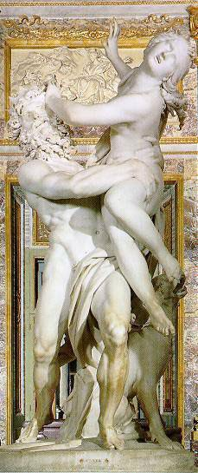
Apollo and Daphne
Pluto and Proserpina
by Gian Lorenzo Bernini
1598-1642 in the Borghese Museum, Rome
16

Slide 17
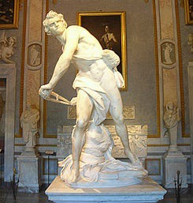
David by
Gian Lorenzo Bernini (1598-1642) at the
Villa Borghese Museum
17

Slide 18
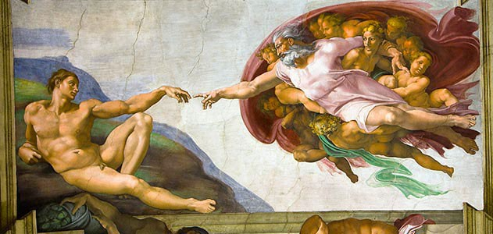
The Creation of Adam by Michelangelo (1475-1564) in the Sistine Chapel in St. Peter’s Basilica, Rome

Slide 19
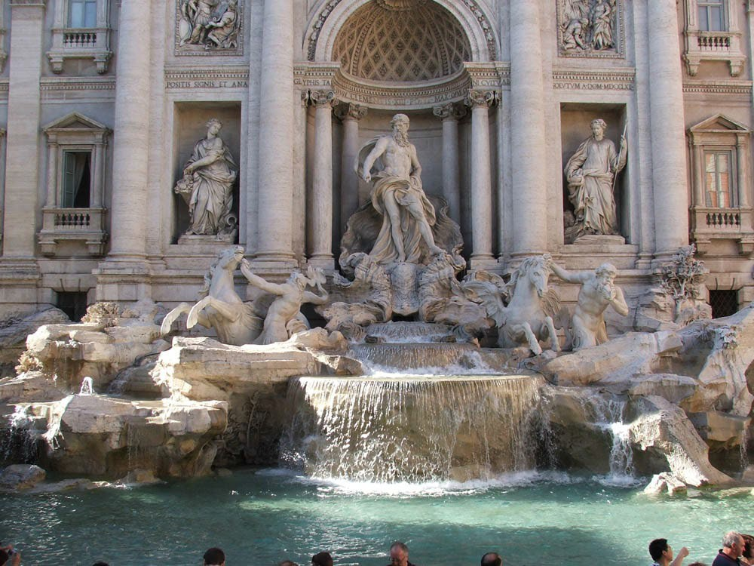
Imagine being Here!!
Fontana di Trevi (Trevi Fountain, Rome)

